Slide 1
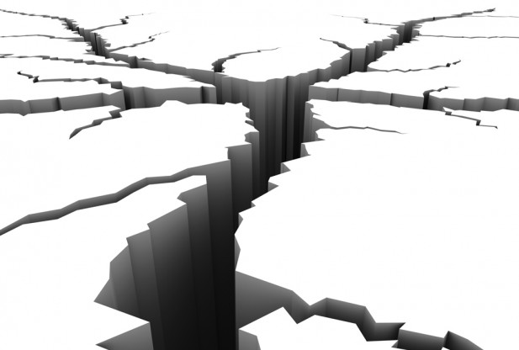
Destructive Forces:
EARTHQUAKES

Slide 2
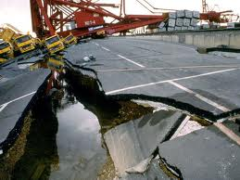
What are Destructive Forces?
A destructive force is a process that lowers or tears down the surface features of the Earth.

Slide 3
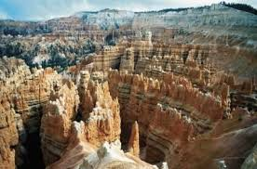
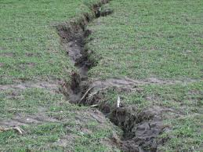
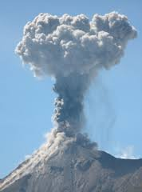
Examples of Destructive Forces:
Destructive forces can occur in many ways. The following are common examples of destructive forces:
Earthquakes
Erosion
Weathering
Volcanoes

Slide 4
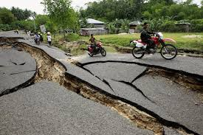
Earthquakes
One of the most devastating forms of destructive forces are earthquakes.
Earthquakes are the result of a sudden release of energy in the Earth's crust that creates seismic waves.

Slide 5
Why Earthquakes Happen
Earthquakes are caused by the movement of plates below the Earth's surface.
The places where these plates meet are breaks in the Earth's crust called faults.
Earthquakes often happen when these plates along the faults move in different directions.

Slide 6
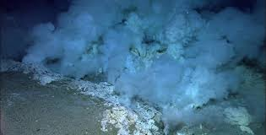
Where Earthquakes Happen
95% of all the world's earthquakes occur at active plate boundaries located in California, Alaska, Japan, South America, and the Philippines.
The edges of the giant Pacific plate, which lies beneath the Pacific Ocean, form an intense ring of tectonic activity, known as the "ring of fire." This activity causes frequent earthquakes along the west coast of North America and in Chile, Alaska, and Japan.

Slide 7
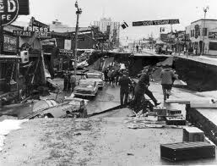
Major Earthquakes
The largest recorded earthquake in the United States was a magnitude 9.2 that struck Prince William Sound, Alaska on March 28, 1964.
The largest recorded earthquake in the world was a magnitude 9.5 in Chile on May 22, 1960.

Slide 8
Georgia Earthquake Facts
The first reported earthquake in Georgia was felt as a result of great New Madrid series of earthquakes in 1811 - 1812.
Georgia was also impacted by the large Charleston, South Carolina earthquake of 1886; it caused severe shaking throughout the state.
Since then Georgia has had a few minor earthquakes that where felt more in the northern counties.
Real-time Earthquake Facts

Slide 9
Earthquake Videos
http://www.youtube.com/watch?v=CtBXTvtFaCU
http://www.youtube.com/watch?v=u8hfCN6k3YE

