Slide 1
Parallelogram
2 sets of parallel sides
2 sets of congruent sides
0 right angles
Trapezoid

Slide 2
Rectangle
2 sets of parallel sides
2 sets of congruent sides
4 right angles
Trapezoid and parallelogram

Slide 3
Rhombus
2 sets of parallel sides
4 congruent sides
0 right angles
Trapezoid and parallelogram

Slide 4
Square
2 sets of parallel sides
4 congruent sides
4 right angles
Trapezoid, parallelogram, rectangle, and rhombus

Slide 5
Trapezoid
1 sets of parallel sides
0 sets of congruent sides
2 right angles

Slide 6
Trapezoid
1 sets of parallel sides
0 sets of congruent sides
0 right angles

Slide 7
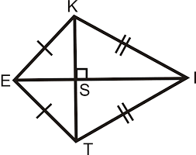
In Euclidean geometry, a kite is a quadrilateral whose four sides can be grouped into two pairs of equal-length sides that are adjacent to each other. In contrast, a parallelogram also has two pairs of equal-length sides, but they are opposite to each other rather than adjacent.

